Slide 1
主題：隋代大運河
總論
中國的河流都是由西流向東的。在隋朝，為了把江南所生產的糧食，源源不絕地運送到首都大興，以及北方的軍事邊鎮，建築了五條運河 。這種人工河道，將農業富庶的江南，連接到首都大興（長安）這個西面的政治中心，和涿郡（北京）這個北面的邊境重鎮，對隋帝國的穩定和統一起了非常重要的作用，同時也推動了東西和南北經濟的發展。
在本課題，你將可以學到：
什麼是運河
隋代建築運河的經過
隋代建築運河的影響
教學節數建議：4
孝文帝像（百度百科）

Slide 2
Topic: The Grand Canal in the Sui Dynasty
Summary
Most Chinese rivers flow eastward. To ensure that there were sufficient crops transported from Jiangnan to the capital Da’xing and the northern frontier garrisons, five canals were constructed in the Sui Dynasty. These artificial waterways connected the wealthy Jiangnan district (Yangzi River delta) to the western political centre—Da’xing (Chang’an) and the northern frontier garrison—the Zhuo commandery (Beijing). And they played important roles in stabilizing and unifying the Sui Dynasty as well as fostering east-west and south-north economic developments.
In this topic, you will learn:
What a canal is
Process of constructing canals in the Sui Dynasty
Impact of constructing canals in the Sui Dynasty
Recommended Number of Lessons: 4
孝文帝像（百度百科）

Slide 3
學習重點
認識運河的特點
認識隋代建築運河的經過
3. 認識隋代建築運河的影響

Slide 4
Learning Objectives
To know the characteristics of a canal
To know the process of constructing canals in the Sui Dynasty
To know the impact of constructing canals in the Sui Dynasty

Slide 5
本節關鍵詞 (Key Terms)
 | 英文詞彙 | 中文詞彙/粵語拼音 | 中文詞彙/普通話拼音
1 | canal | 運河 (wan6 ho4) | 運河 (yùn hé)
2 | Emperor Wen of the Sui Dynasty | 隋文帝 (ceoi4 man4 dai3) | 隋文帝 (suí wén dì)
3 | Emperor Yang of the Sui Dynasty | 隋煬帝 (ceoi4 joeng6 dai3) | 隋煬帝 (suí yáng dì)
4 | Jiangnan (The southern part of the Yangzi River Delta) | 江南 (gong1 naam4) | 江南 (jiāng nán)
5 | Yangzi River | 長江 (coeng4 gong1) | 長江 (cháng jiāng)
6 | Huai River | 淮河 (waai4 ho4) | 淮河 (huái hé)
7 | Yellow River | 黃河 (wong4 ho4) | 黃河 (huáng hé)
8 | Yuhang | 餘杭 (jyu4 hong4) | 餘杭 (yú hang)
9 | Da’xing | 大興 (daai6 hing1) | 大興 (dà xīng)
10 | granaries | 糧倉 (loeng4 cong1) | 糧倉 (liáng cāng)

Slide 6
本節概要
在隋朝，為了把江南所生產的糧食，源源不絕地運送到首都大興，以及北方的軍事邊鎮，建築了五條運河。
隋朝的運河，貫穿了黃河、淮河和長江，而洛陽成為這新交通網絡的中心城市。
運河對隋帝國的穩定和統一起了非常重要的作用，同時也推動了東西和南北經濟的發展。

Slide 7
Key Points of the Chapter
To ensure that there were sufficient crops transported from Jiangnan to the capital Da’xing and the northern frontier garrisons, five canals were constructed in the Sui Dynasty.
The canals of the Sui Dynasty linked the Yellow River, the Huai River and the Yangzi River together. Luoyang became a hub of the new transportation network.
Canals played important roles in stabilizing and unifying the Sui Dynasty as well as fostering east-west and south-north economic developments.

Slide 8
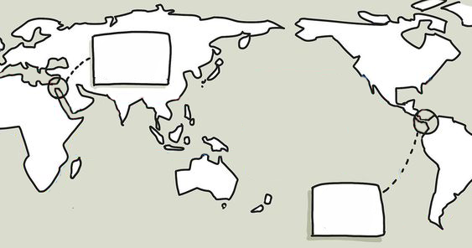

世界各地運河
你知道世界最有名是哪兩條運河？它們的名字分別是蘇伊士運河和巴拿馬運河。請把它們填在地圖適當的位置上。

Slide 9
Canals around the world
Do you know where the world’s most famous canals, the Suez Canal and the Panama Canal, are respectively? Fill in their names in the appropriate space on the map.

Slide 10
世界各地運河
蘇伊士運河
你知道世界最有名是哪兩條運河？它們的名字分別是蘇伊士運河和巴拿馬運河。請把它們填在地圖適當的位置上。
好望角
問題思考：
這兩條運河在交通上有什麼作用？
蘇伊士運河：
巴拿馬運河：
巴拿馬運河
連結了歐洲與亞洲，船隻不必繞過非洲南端的好望角。
連接太平洋與大西洋，船隻不必繞過南美洲的南端合恩角。
合恩角

Slide 11
Canals around the world
Suez Canal
Do you know where the world’s most famous canals, the Suez Canal and the Panama Canal, are respectively? Fill in their names in the appropriate space on the map.
Cape of Good Hope
Questions:
What roles do these two canals play in transportation?
The Suez Canal:
The Panama Canal:
Panama Canal
connecting Europe to Asia such that ships need not go around the Cape of Good Hope in South Africa.
connecting the Pacific Ocean to the Atlantic Ocean such that ships need not to go around the Cape Horn in the southern headland of South America.
Cape Horn

Slide 12
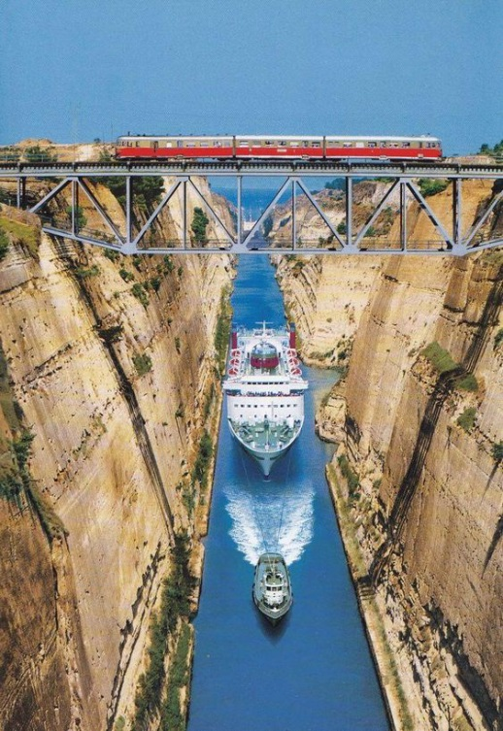
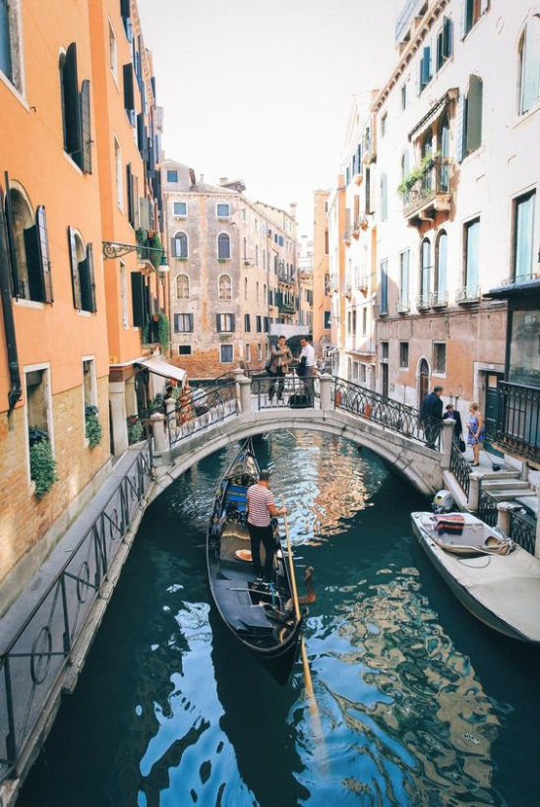
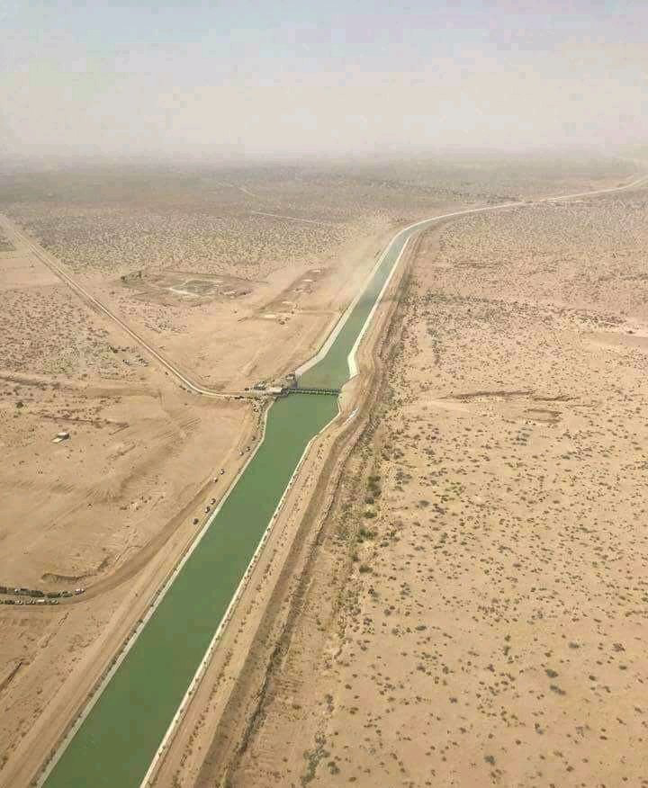
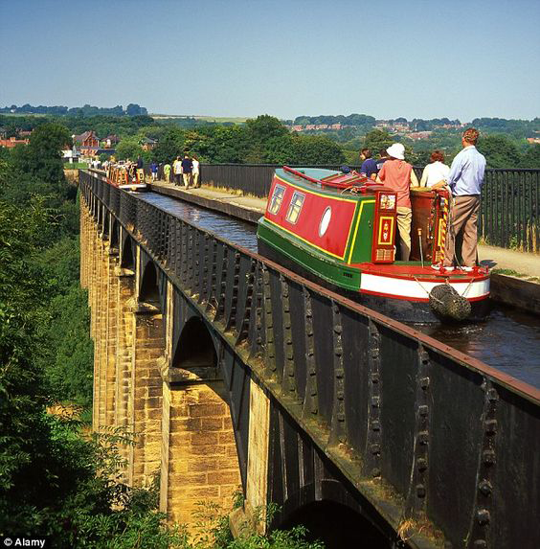

世界各地運河
B
C
D
A
配對：圖中都是世界有名的運河，你知它們在哪些國家？請你把有關的數字填在圖片上：
① 巴基斯坦
② 意大利
③ 希臘
④ 英國
互聯網圖片

Slide 13

Canals around the world
B
C
D
A
Matching: The above images show some world-renowned canals. Do you know where are they located? Please write down the numbers on the relevant images.
① Pakistan
② Italy
③ Greece
④ Britain
Images from the Internet

Slide 14

世界各地運河
B
③ 希臘
C
② 意大利
D
① 巴基斯坦
A
④ 英國
配對：圖中都是世界有名的運河，你知它們在哪些國家？請你把有關的數字填在圖片上：
① 巴基斯坦 （巴基斯坦旁遮普省）
② 意大利 （意大利威尼斯）
③ 希臘
④ 英國 （英國威爾斯）
互聯網圖片

Slide 15


Canals around the world
B
③ Greece
C
② Italy
D
① Pakistan
A
④ Britain
Matching: The above images show some world-renowned canals. Do you know where are they located? Please write down the numbers on the relevant images.
① Pakistan (the Pakistani province of Punjab)
② Italy (Venice)
③ Greece
④ Britain (Wales)
Images from the Internet

Slide 16
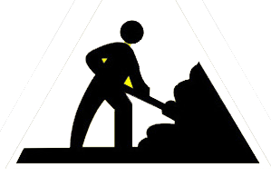
怎樣修建運河？
運河是人工開鑿的河流，是需要處理大量泥土工程，但最重要找到合適的水源。
一般來說，有兩個方法：
2. 擴闊天然河道，並把部分彎曲的河道改為直道，以方便大型船隻航行。
1. 選擇在天然河道附近修築一條運河，然後再修建一條引水道，把天然河道的水引入運河。
新河道
舊河道
水流
天然河道
引水道
人工河道

Slide 17
How to construct a canal?
Canals are artificial waterways. They require heavy dredging works, and most importantly finding suitable headwaters. Generally, there are two ways to create a canal.
1. Construct a canal near a natural waterway. Dig a catchment channel to drain water from the natural waterway to the canal.
2. Enlarge the natural waterway and reduce its meanders to allow sailing of large ships.
New waterway
Previous waterway
Water flow
Natural waterway
Catchment channel
Artificial waterway

Slide 18
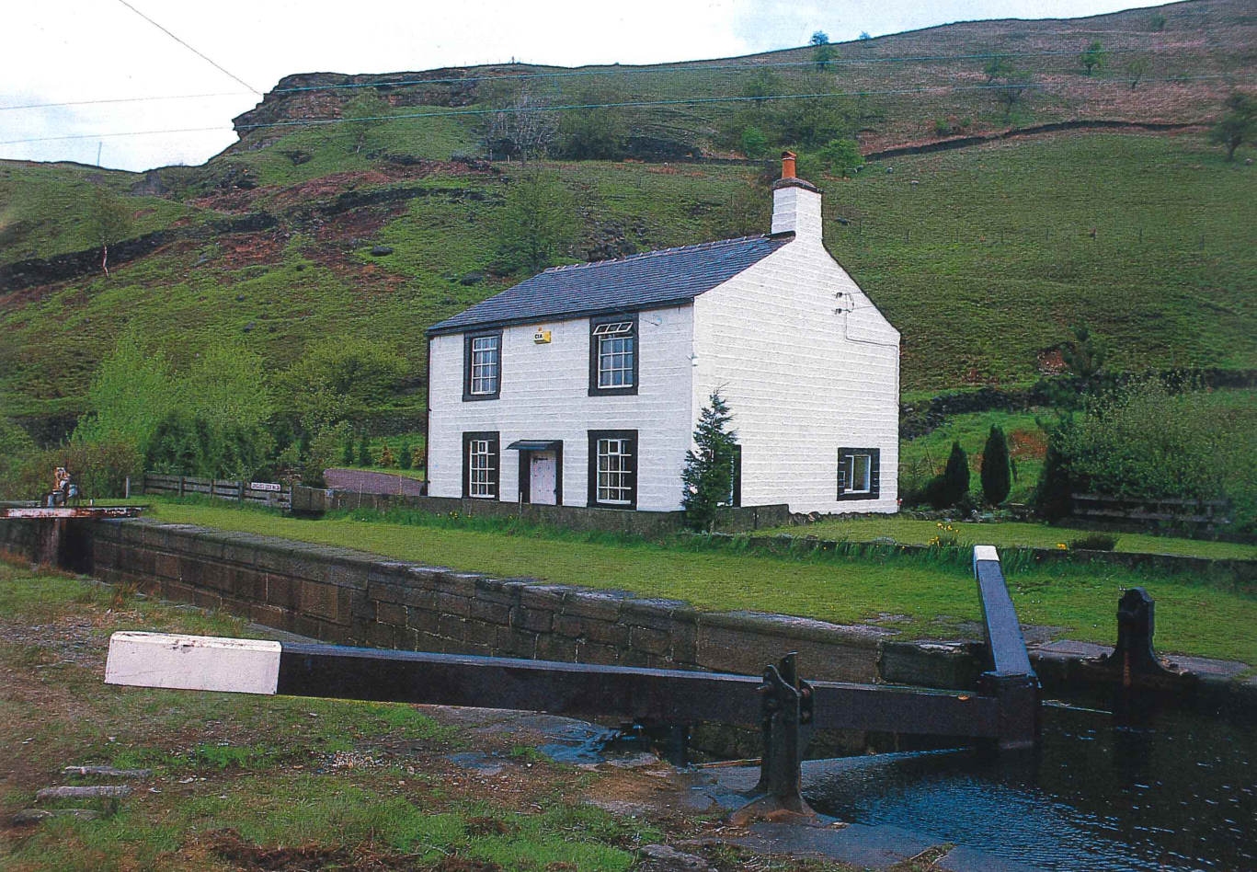

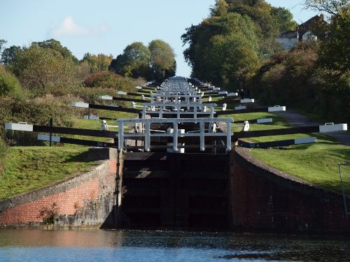
運河上的建築 – 水閘
水閘的作用是調節運河內的水位高度。
利用水閘，運河內的船便可以翻過高山。
向下施加壓力，便可打開水閘，而水便從一區流到另一區，船也順利通過。
Source: Anthony Burton, The Great Days of the Canals, London: Tiger Book International, 1989.

Slide 19
Constructions above the canal—Locks
Locks help regulate the water level in the canal. With them, ships in the canal can easily sail up high hills.
The lock will be opened by the downward pressure. Water will then flow from this gate to the next gate as the ship passes.
Source: Anthony Burton, The Great Days of the Canals, London: Tiger Book International, 1989.

Slide 20
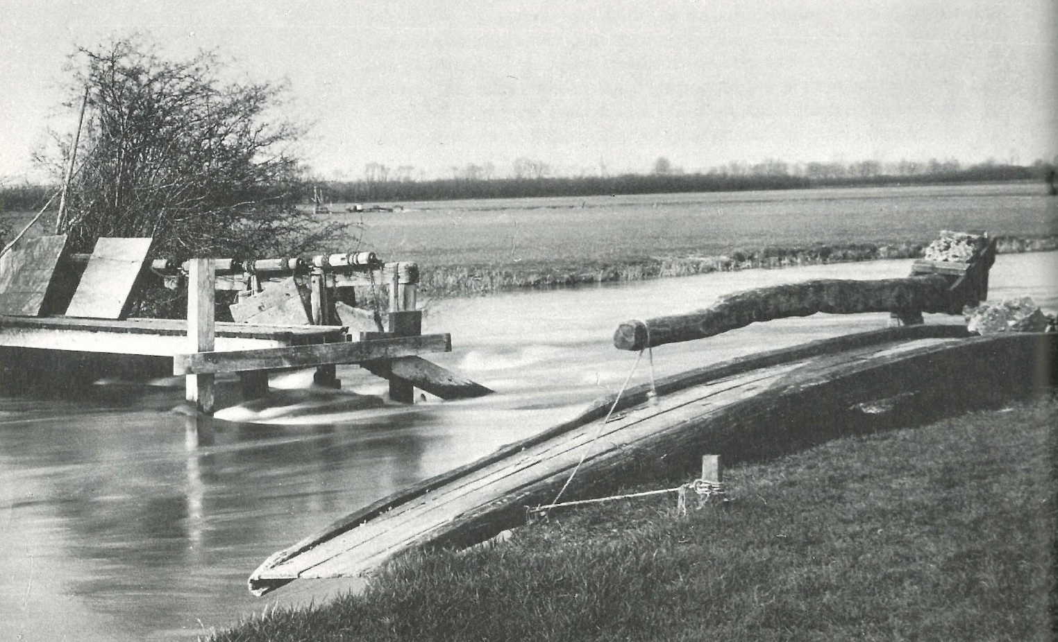

運河上的建築 – 可移動的木橋
課堂討論：我如何可以走過對岸？為什麼運河上有這樣的建築？
Source: Burton, The Great Days of the Canals

Slide 21
Constructions above the canal—Movable Wooden Bridge
Class discussion: How can I cross the river? Why is this built above the canal?
Source: Burton, The Great Days of the Canals

Slide 22

運河上的建築 – 可移動的木橋
課堂討論：我如何可以走過對岸？為什麼運河上有這樣的建築？
（答案：這是一座可供開合的木橋，張開時（像左圖），船可以通過；當遇到有人過橋，他只需要把右面的長木柄向前推移，便能夠將橋接通起來，人也可以通過了。）
長木柄
Source: Burton, The Great Days of the Canals

Slide 23
Constructions above the canal—Movable Wooden Bridge
Class discussion: How can I cross the river? Why is this built above the canal?
(Answer: This is a movable wooden bridge that can be opened for ships to pass through. It can also be connected to the other side to form a bridge by moving forward the long wooden handle.)
Long wooden handle
Source: Burton, The Great Days of the Canals

Slide 24

運河上的建築 – 迴旋形石橋
課堂討論：奇怪了！為何運河邊的橋被設計成迴旋形狀？相較直角形的設計，這累我要多走路啊！
Source: Burton, The Great Days of the Canals

Slide 25
Constructions above the canal—Turnover Bridge
Class discussion: How odd! Why is the bridge along the canal a swivel shape? I would need to walk more here than if it were a straight perpendicular design!
Source: Burton, The Great Days of the Canals

Slide 26

運河上的建築 – 迴旋形石橋
課堂討論：奇怪了！為何運河邊的橋被設計成迴旋形狀？相較直角形的設計，這害我多走路啊！
這橋的設計原來是方便我的！
（答案：這種設計，是方便騾馬車在狹窄的河邊過橋的。）
Source: Burton, The Great Days of the Canals

Slide 27
Constructions above the canal—Turnover Bridge
Class discussion: How odd! Why is the bridge along the canal a swivel shape? I would need to walk more here than if it were a straight perpendicular design!
This bridge’s design is convenient to me!
(Answer: This design is convenient for mule-drawn carriages to cross the bridge near narrow towpaths.)
Source: Burton, The Great Days of the Canals

Slide 28
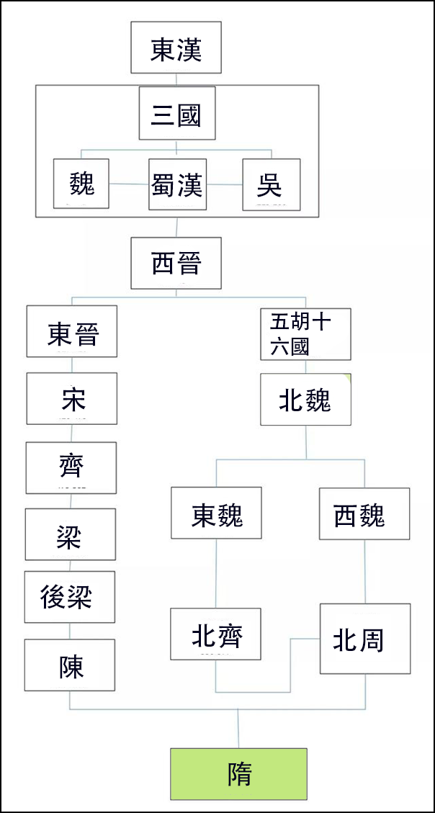
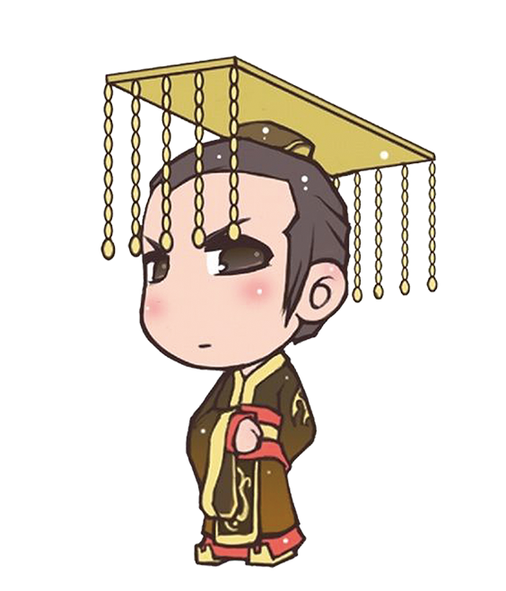
隋代修建運河的背景
填充：
公元581年，楊堅統一中國，建立______朝，成為隋文帝。
在統一的過程中，楊堅分別結束了南北兩個政權，南的是________；北的是________。
隋
陳朝
北周
南朝
北朝
楊堅（隋文帝）小檔案
出生： 541年
登基：581年
成功秘訣：本是北周丞相，掌握軍政大權，最後迫北周皇帝讓位。
統一：581年滅陳朝，中國統一。

Slide 29
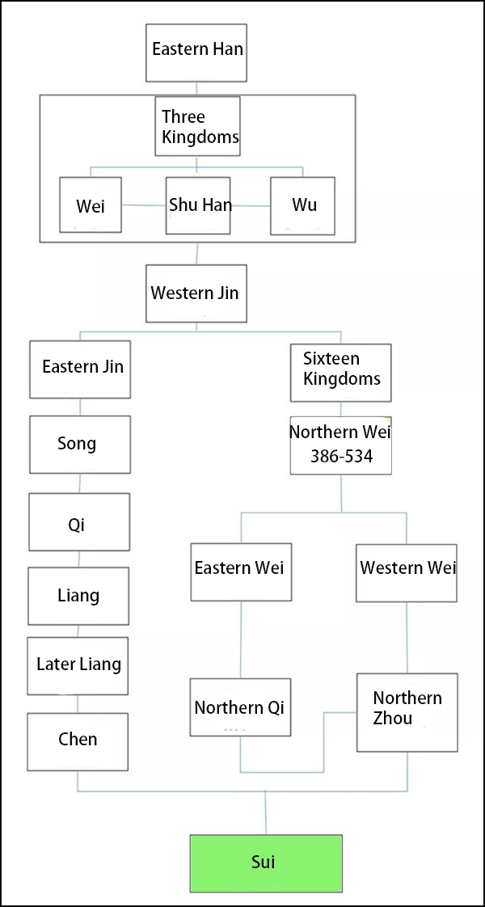
Background of Constructing Canals in the Sui Dynasty
Fill in the blanks:
In A.D. 581, Yang Jian united China, established the Dynasty, and became Emperor Wen of the Sui Dynasty.
Yang abolished two regimes in his unifying process, the one in south was _______________; while the one in north was _______________________.
Sui
the Chen Dynasty
the Northern Zhou Dynasty
The Southern Dynasties
The Northern Dynasties
Sixteen Kingdoms founded by Five Barbarian Groups
Profile of Yang Jian (Emperor Wen of the Sui Dynasty)
Year of birth: A.D. 541
Year of enthronement: A.D. 581
Key to success: Became a powerful Grand Councilor of the Northern Zhou Dynasty and forced his emperor to abdicate
Unification process: Conquered the Chen Dynasty in A.D. 581 and thus unified China

Slide 30
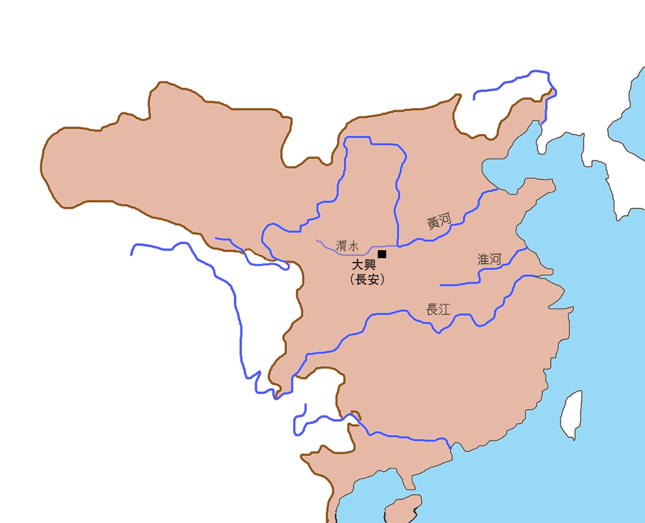




隋代修建運河的背景
西突厥
東突厥
高麗
維持統一的大帝國一點也不容易，隋朝北方有三個敵人，分別是_____、_____和_____。
要保護自己的帝位，我必須要在____ （隋朝首都）加強兵力---至少要10萬以上。
問題是：大興並非農業區域，如何可以保證駐扎軍隊有充足的糧食？
西突厥
東突厥
高麗
大興
底圖：百度百科—隋朝圖片

Slide 31

Background of Constructing Canals in the Sui Dynasty
Western Turks
Eastern Turks
Goryeo
It is hard to maintain a united empire under the threats from ___________, ___________and _____ on the northern side of the Sui Dynasty.
I must garrison more troops—at least 100,000 soldiers in ______ (capital of the Sui Dynasty) to prolong my rule.
How should I ensure sufficient crop supplies to the garrison troops even though Da’xing is not an agricultural area?
the Western Turks
the Eastern Turks
Goryeo
Da’xing
Base map：百度百科—隋朝圖片

Slide 32


隋代修建運河的背景
政治中心
長江以南，俗稱「江南」，是農業富庶區域，餘杭是其中的大城市。
農業區域
要想個辦法，把江南生產的穀物運送到大興去養兵。

Slide 33
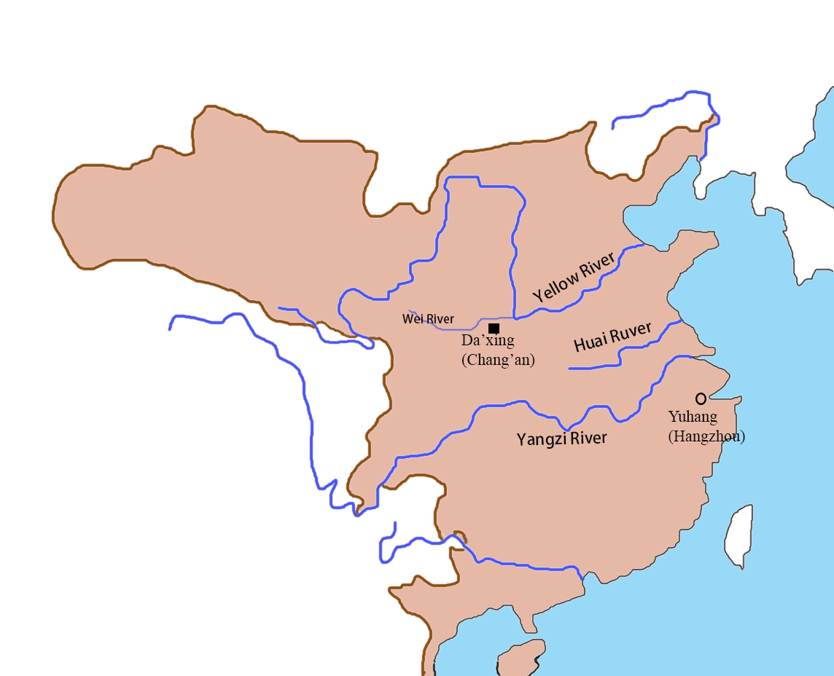

Background of Constructing Canals in the Sui Dynasty
The southern part of the Yangzi River Delta, known as Jiangnan, was an affluent agricultural area. Yuhang was one of the major cities.
Political centre
Agricultural area
We have to think of a way to transport grains from Jiangnan to Da’xing to maintain the army.

Slide 34

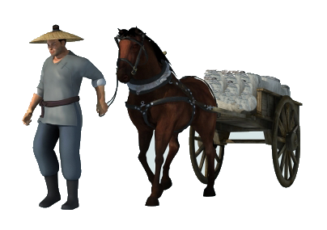
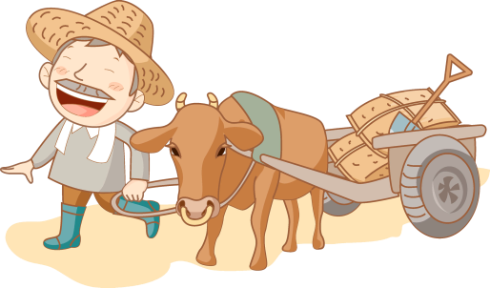
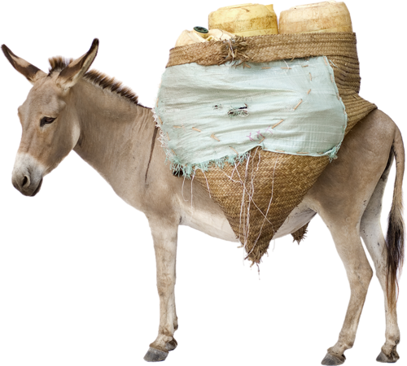
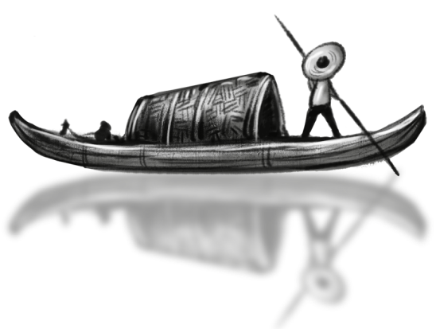

修建運河的考慮：運輸工具比拼
請觀看以下的短片，然後回答問題：
Learning from Home: Build your own Canal (Eng, Eng subtitle, 4:30 mins)
https://www.youtube.com/watch?v=hYmEoxnJgw8
人肩挑
從短片學習所得，如果隋文帝要把穀物從餘杭運送到大興首都，
以下哪種交通工具最為便利？請把你的答案圈出來。
馬車
牛車
用驢
馱運
駱駝車
船

Slide 35
Concerns over Constructing Canals: Transportation Methods
Watch the video below and answer the question:
Learning from Home: Build your own Canal (Eng, Eng subtitle, 4:30 mins)
https://www.youtube.com/watch?v=hYmEoxnJgw8
Carry on one’s shoulders
As shown from the video, if Emperor Wen of the Sui Dynasty wanted to transfer crops from Yuhang to the capital Da’xing, which of the following transportation methods should he choose? Circle your answer.
Horse-drawn carriage
Cow-drawn carriage
Camel-drawn carriage
Pack mule
Boat

Slide 36
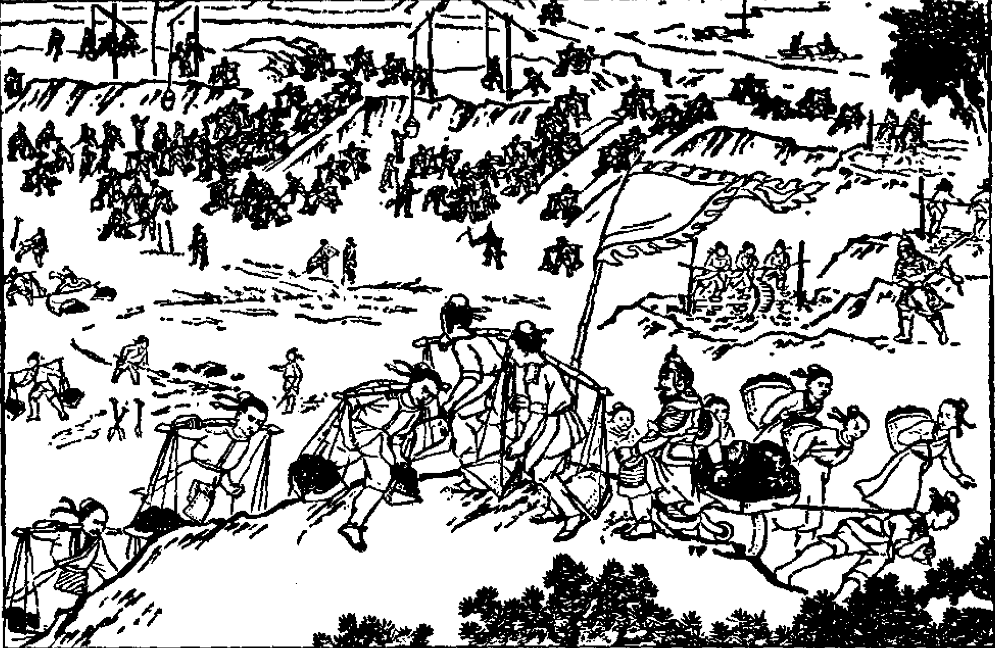
修建運河的考慮：動用的人力
在中國古代，修建運河，是國家的巨大工程。政府需要徵召數以十萬計的民夫，日以繼夜地工作。
圖片:《中國古代史常識—隋唐五代宋元部分》，北京：中國青年出版社，1979年。

Slide 37
Concerns over Constructing Canals: Manpower Mobility
Constructing canals were giant projects to the empires in ancient China. The government had to mobilize hundreds of thousands of civilians to work around the clock.
Picture:《中國古代史常識—隋唐五代宋元部分》，北京：中國青年出版社，1979年。

Slide 38
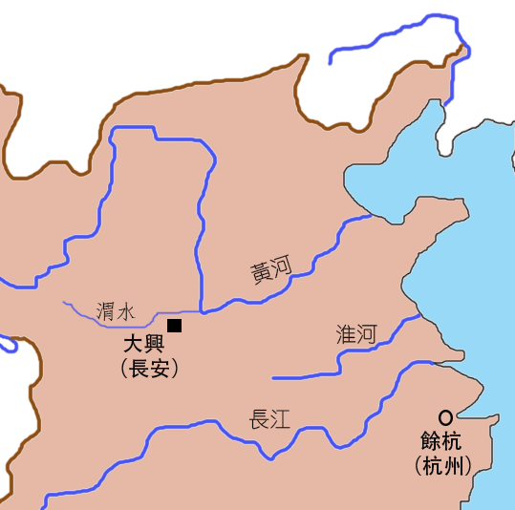
修建運河的考慮：路線的規劃
同學：請幫我設計一條由餘杭直達大興的運河。你可先用筆在左圖上做一個草圖。
（注意：渭水的河水少，不利大船航行，那裡也要一條運河。）

Slide 39
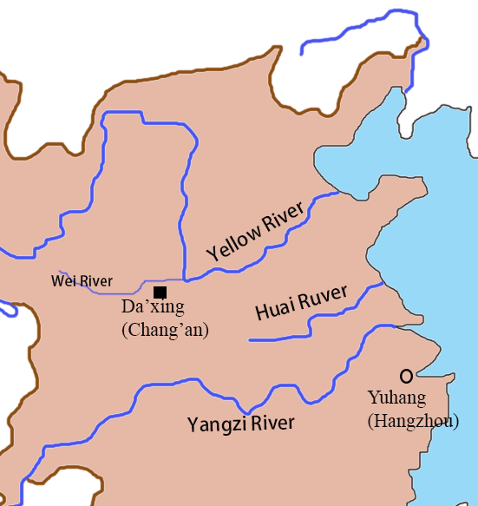
Concerns over Constructing Canals: Route Planning
Please help me to design a canal connecting Yuhang to Da’xing. You can draft it on the left picture.
(Reminder: the Wei River also requires a canal as its flow is too weak to support the sailing of large ships.)

Slide 40
修建運河的考慮：路線的規劃
你的草圖是否與我的想法一致？

Slide 41
Concerns over Constructing Canals: Route Planning
Did you have a similar idea to mine?

Slide 42
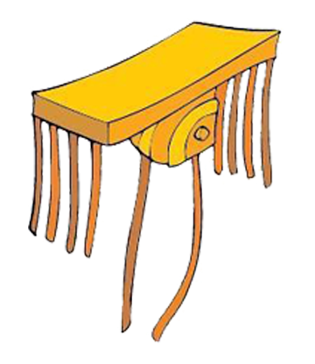
修建運河的考慮：路線的規劃
由於工程過於浩大，這四段運河的修建經歷了隋代兩個皇帝。
隋文帝
（統治581-604）
隋煬帝
（統治604-618）
江南河
廣通渠
(連接餘杭與長江)
(連接黃河與大興)
通濟渠
(連接黃河與淮河)
山陽瀆
(連接淮河與長江)
考考你：
請你把以上四段運河配置到地圖上

Slide 43
Concerns over Constructing Canals: Route Planning
Owing to the huge scale of works, the construction of the four canals lasted through the terms of two emperors of the Sui Dynasty.
Emperor Yang of the Sui Dynasty
(Reign: 604-618)
Emperor Wen of the Sui Dynasty
(Reign:581-604)
Jiangnan Canal
Guangtong Canal
(joining the Yangzi River and Yuhang)
(joining the Yellow River and Da’xing)
Tongji Canal
(joining the Yellow River and the Huai River)
Shanyangdu Canal
(joining the Huai River and the Yangzi River)
Quick test：
Please match the above canals to their locations on the map.

Slide 44
修建運河的考慮：路線的規劃
由於工程過於浩大，這四段運河的修建經歷了隋代兩個皇帝。
隋文帝
（統治581-604）
隋煬帝
（統治604-618）
廣通渠
通濟渠
山陽瀆
江南河
考考你：
請你把以上四段運河配置到地圖上

Slide 45
Concerns over Constructing Canals: Route Planning
Owing to the huge scale of works, the construction of the four canals lasted through the terms of two emperors of the Sui Dynasty.
Emperor Yang of the Sui Dynasty
(Reign: 604-618)
Emperor Wen of the Sui Dynasty
(Reign:581-604)
Guangtong Canal
Tongji Canal
Shanyangdu Canal
Jiangnan Canal
Quick test：
Please match the above canals to their locations on the map.

Slide 46


修建運河的考慮：路線的規劃
第五段運河—永濟渠
公元608年，隋煬帝下令開鑿了隋朝的第五段運河—永濟渠，目的是將物資送到涿郡，支援攻打高麗的軍隊，保障東北邊境的安全。
永濟渠的開鑿—
打通了南（杭州）北（北京）的交通。
高麗
涿郡
（北京）
征高麗
永濟渠
廣通渠
通濟渠
山陽瀆
江南河

Slide 47
Concerns over Constructing Canals: Route Planning
The fifth canal: Yongji Canal
In A.D. 608, Emperor Yang of the Sui Dynasty commanded the construction of Yongji Canal, the fifth canal of the Sui Dynasty. It helped supply troops in the Zhuo commandery to conquer Goryeo and to safeguard the northeast frontier.
Building the Yongji Canal connected the south (Hangzhou) to the north (Beijing).
Goryeo
Zhuo commandery
(Beijing)
Yongji Canal
Guangtong Canal
Tongji Canal
Shanyangdu Canal
Jiangnan Canal

Slide 48
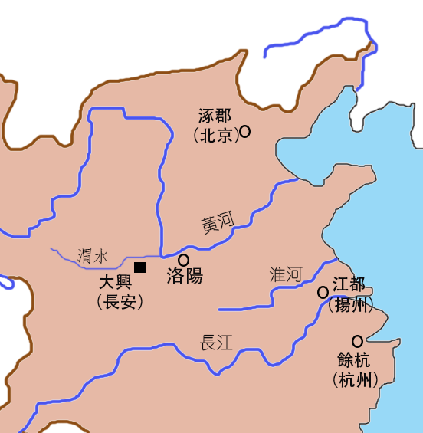
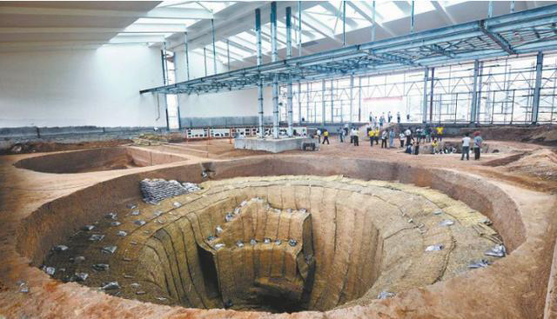
運河發揮的功能：糧食的運輸及貯存
互聯網圖片
隋朝的運河，貫穿了黃河、淮河和長江，而洛陽成為這新交通網絡的中心城市。
1969年，考古學家在洛陽發現隋代的大型糧倉（含嘉倉）遺址。
含嘉倉的總面積是43萬平方米，相等於60個香港的大球場。
在這個龐大的範圍內，共建有倉窖400個。
這是含嘉倉的其中一個倉窖，主體建築在地下，深若10米。

Slide 49
Functions of Canals: Storage and Transfer of Crops
The canals of the Sui Dynasty linked the Yellow River, the Huai River and the Yangzi River together. Luoyang became a hub of the new transportation network.
In 1969, archaeologists discovered large-scale remains of government granaries (the Hanjia Granary) of the Sui Dynasty in Luoyang.
It had 400 granaries with a total area of 430,000 m² (the equivalent of 60 Hong Kong Stadiums).
Zhuo commandery
(Beijing)
Luoyang
This was one of the granaries in the Hanjia Granary that was built underground with 10 meters depth.

Slide 50
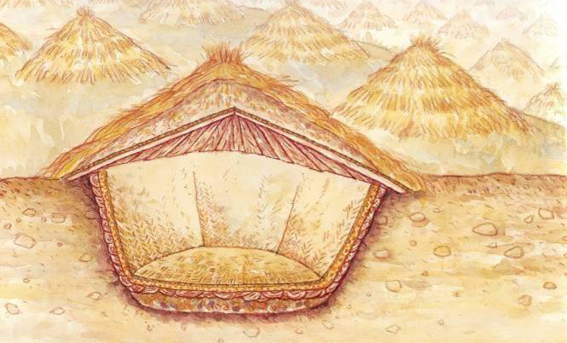
運河發揮的功能：糧食的運輸及貯存
洛陽天氣比較乾旱，因此儲存在倉窖內的穀物，可以保存很長的時間而不會腐爛。
圖片：《中華文明傳真》第6冊隋唐，上海：上海辭書出版社，2001年。

Slide 51
Functions of Canals: Storage and Transfer of Crops
Because of the dry weather in Luoyang, crops could be stored durably in granaries without decay.
Image：《中華文明傳真》第6冊隋唐，上海：上海辭書出版社，2001年。

Slide 52
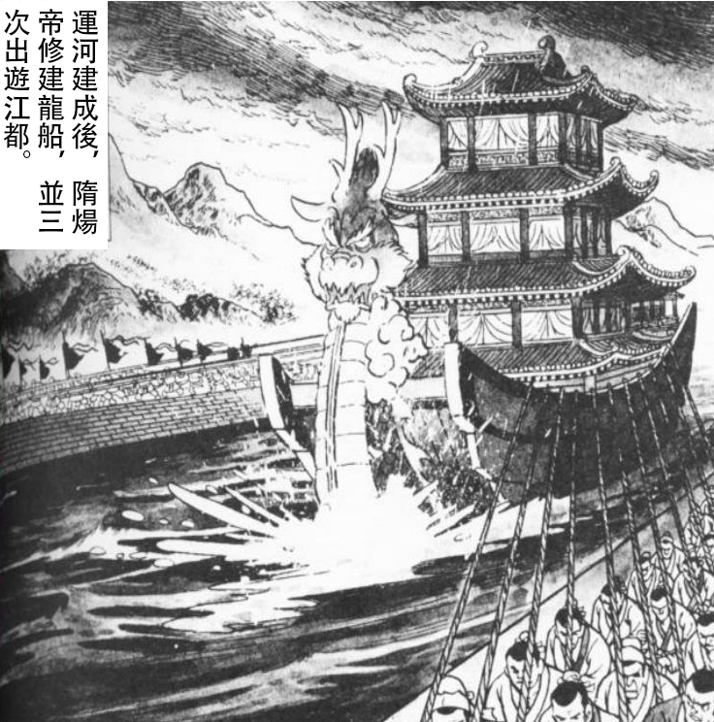
運河的另類功能：帝王遊玩
互聯網圖片
1
2
3
隋煬帝的龍船從洛陽開到江都，需要經過三條天然或人工河道，請你指出來：
1.
2.
3.
黃河
通濟渠
山陽瀆

Slide 53
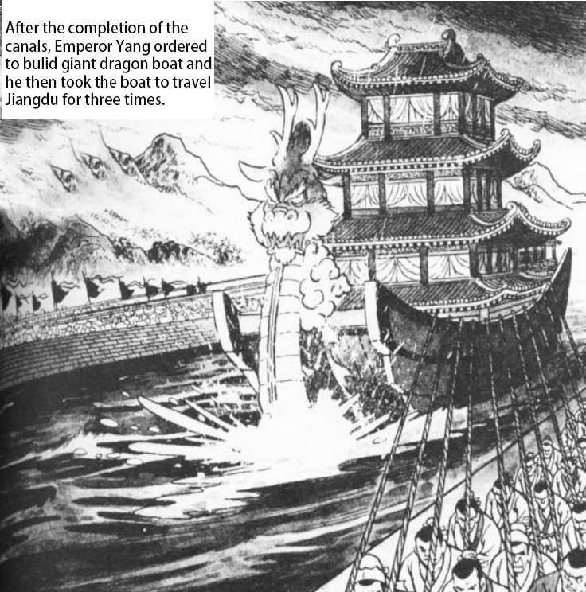
Alternative function of canals: emperors’ recreation
Zhuo commandery
(Beijing)
1
2
Luoyang
Jiangdu (Yangzhou)
3
Sailing from Luoyang to Jingadu, Emperor Yang’s dragon boat had to pass through three natural or artificial waterways. They were:
1.
2.
3.
The Yellow River
Tongji Canal
Shanyangdu Canal

Slide 54
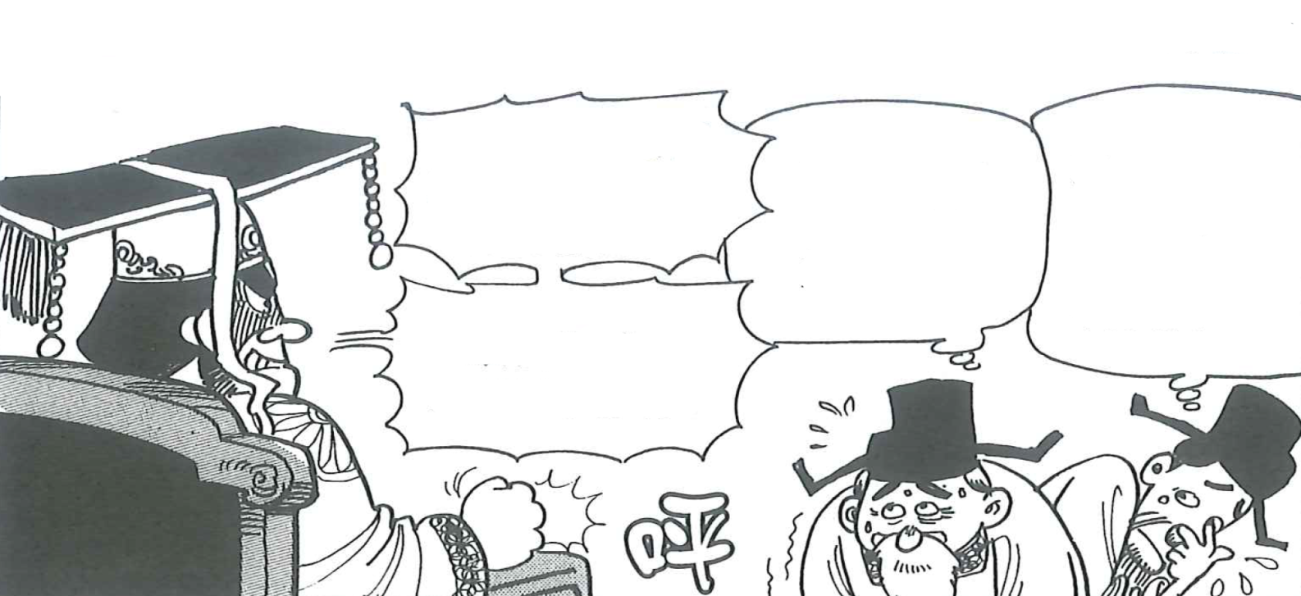
要不要修建運河？
請參閱左圖，回答以下問題：
1. 根據左圖，隋煬帝說他為什麼要修建大運河？
答：
參考兩位大臣的意見，請指出改善交通對隋帝國什麼具體的好處？✔
答：
□ 駐守大興的軍隊有足夠的糧食供應，首都安全。
□ 多吃食物，增強國民的體質。
□ 商人利用運河運輸貨物，促進中國各地的商業往來。
□ 把糧食運輸至東北邊境，鞏固了帝國的安全。
□ 快速運輸軍事物資，有利隋政府討平地方叛亂，維持國家的統一。
隋煬帝在位時，耗費了巨大的人力物力，完成了接近兩千公里的大運河。
改善全國交通。
大運河改善了全國交通，有什麼好處？
運送軍用物資較前方便了，有利國家統一。
商人可以將貨物運到各處售賣，有利商業發展。
✔
快說！
✔
✔
底圖：《中國歷史1000年》，台北：漢湘文化事業股份有限公司，2004年。
✔

Slide 55
The Decision to Construct the Canals
Using the source, answer the following questions：
Why would Emperor Yang of the Sui Dynasty build the Grand Canal?
Answer:
According to the opinions of the two officials, what were the specific benefits brought by the advancement of transportation? ✔
Answers:
□ It guaranteed sufficient food supply to the garrison troops in Da’xing, which made the capital more secure.
□ Civilians could consume more food to strengthen their physique.
□ Merchants could make use of the canals to ship their goods. It therefore promoted commercial activities in China.
□ It transported crops to northeast frontiers to safeguard the security of the empire.
□ It transferred military equipment rapidly to enable the Sui government to suppress any uprisings and maintain national unification.
During the reign of Emperor Yang of the Sui Dynasty, vast amounts of manpower and money were invested to construct the Grand Canal that was nearly 2000 kilometers long.
To enhance national transportation
The construction of the Grand Canal improves national transportation. But what actual benefits does it have？
It promotes national unification as it is easier to deliver military supplies.
It fosters commercial developments since merchants can ship and sell their products everywhere.
✔
Be quick!
✔
✔
✔
Background image：《中國歷史1000年》，台北：漢湘文化事業股份有限公司，2004年。

Slide 56
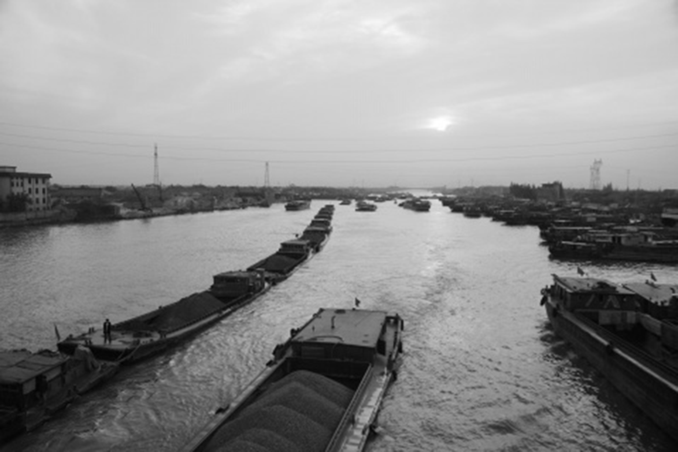
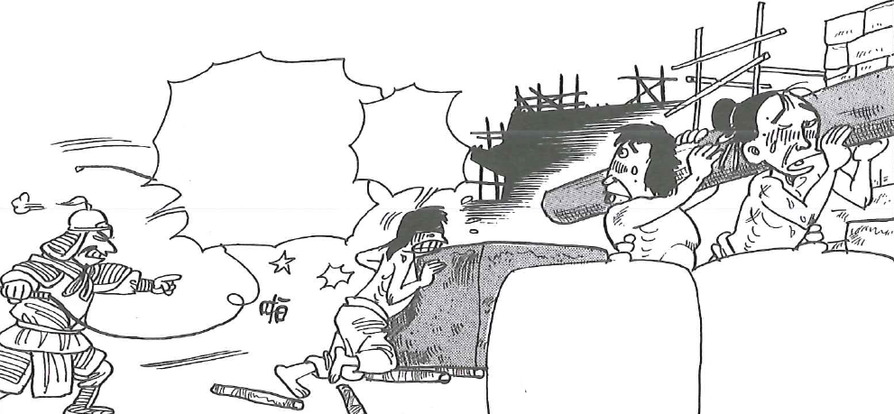
要不要修建運河？
課堂討論：參閱A和B的資料後，你覺得隋煬帝應不應該建運河？
A. 這項龐大的國家工程，由於大量徵召百姓，造成很大民怨。民怨導致了連年的地方叛亂。公元618年，也是隋煬帝登基的第14年，煬帝在巡遊江都期間，被叛軍殺死，隋朝也隨之滅亡。
B. 隋煬帝修建的運河，大大改善了隋朝的交通。其中江南河，到今天還在使用呢！
不許偷懶，快點做事啊！建完運河，還要建龍舟。
媽呀！
我們這些老百姓還真是可憐，何時才可以回家？
這麼大的工程，可不是開玩笑的啊！
底圖：《中國歷史1000年》，台北：漢湘文化事業股份有限公司，2004年。
圖片：百度百科：江南運河
（答案：這沒有既定的答案，不過可以考慮以下：隋朝兩位皇帝在改善交通方面是有貢獻的，問題是政府應該考慮老百姓承受差役的能力。隋朝過度徵用民力，加速了它的滅亡。）

Slide 57
The Decision to Construct the Canals
Class Discussion: With reference to sources A and B, do you think Emperor Yang of the Sui Dynasty should build the canals?
A. The enlistment of countless civilians in this enormous national project created massive grievances. It led to constant rebellions and Emperor Yang was assassinated by the rebels in his cruise to Jiangdu in A.D. 618. The Sui Dynasty perished henceforth.
B. The canals constructed by Emperor Yang drastically improved the transportation of the Sui Dynasty. The Jiangnan Canal is still in use today!
Don’t be lazy!
You have to build the dragon boat after constructing the canal.
Oh my goodness!
They are such huge projects! Are you kidding me?
We are too old for this hardship!
When can we return home?
Background image：《中國歷史1000年》，台北：漢湘文化事業股份有限公司，2004年。
Image：百度百科：江南運河
(This question has no model answer. A sample could be like this: Despite the contributions of the two emperors of the Sui Dynasty in transportation, they overestimated their civilians’ abilities in withstanding the corvee and overexploited them. Therefore, this accelerated the fall of the Sui Dynasty.)

Slide 58
功課：
請同學找出一個所屬國家值得自豪的水利工程（任何歷史時期），
並在課堂上報告和分享。

Slide 59
Homework:
Please search for one hydraulic engineering project from your country (in any period) that makes you proud and share it in the lesson.

Slide 60

本課題提供另外一個利用 sutori 製作的網上互動版，可供學生在家自習 / 溫習之用：
Another online interactive version of this topic produced by sutori is offered to students’ for their self-learning or revision:
隋代大運河：
The Grand Canal in the Sui Dynasty:
https://www.sutori.com/en/story/sui-dai-da-yun-he-the-grand-canal-in-the-sui-dynasty--awo2dobFs5hTxRinho3BuKhv
二維碼：
QR code ：
發佈日期：
Date of issue:
18/1/2022

